Slide 1
Chapter 1: Fundamentals of PHP

Slide 2
What is PHP?
Features of PHP
Setting up PHP with apache
Basic PHP syntax
PHP comments
Predefined and user variables
Variable types in PHP
Retrieve data from html forms
Displaying errors
Using numbers and strings in PHP
Control structures
Conditional and loop statements
Introducing References
References and arrays
Functions
passing arguments by Reference
Functions : returning by Reference
2

Slide 3
Prerequisites:
basic understanding of computer programming,
Internet, Database
Tools
XAMPP
PHP
MySQL
Apache
Browser
3

Slide 4
Background
PHP is a popular high-level scripting language used by a range of organizations and developers.
Originally developed as a small Perl project by Rasmus Lerdorf in late 1995, PHP was intended as a means to assist in developing his home page, and as such he named it Personal Home Page (PHP) Tools.
When Lerdorf was contracted to work for the University of Toronto to build a dial-up system for students to access the Internet, he had no means of connecting Web sites to databases. To solve this problem, the enterprising Lerdorf replaced his Perl code with a C wrapper that added the capability to connect his Web pages to a MySQL database.
As his small project grew, he gave away his changes on the Internet as an Open Source project and cordially received improvements from other programmers with an interest in PHP.
The language was later renamed to the current recursive acronym PHP: Hypertext Preprocessor by Zeev Suraski and Andi Gutmans after they rewrote the parser in 1997.
The software continued to develop and now forms the comprehensive PHP platform we know today.
4

Slide 5
Introduction
PHP is an acronym for "PHP: Hypertext Preprocessor“
PHP is a robust, server-side, open source scripting language
PHP is cross platform
PHP is a server side scripting language that is embedded in HTML
It is used to manage dynamic content, databases, session tracking, even build entire e-commerce sites
PHP provides a solid and well-defined programming language that includes support for
object-orientated programming,
conditions,
file handling,
arithmetic, and more
5

Slide 6
Introduction
It is integrated with a number of popular databases, including MySQL, PostgreSQL, Oracle, Sybase, Informix, and Microsoft SQL Server
PHP supports a large number of major protocols
PHP4 added support for Java and distributed object architectures (COM and CORBA), making n-tier development a possibility
PHP Syntax is C-Like
6

Slide 7
Introduction….
Common uses of PHP
PHP performs system functions, i.e. it can create, open, read, write, and close from files on a system
PHP can handle forms, i.e.
gather data from files, save data to a file, send data through email, and return data to the user
PHP allows to add, delete, modify elements within your database
Access cookies variables and set cookies
restrict users to access some pages of your website
encrypt data
7

Slide 8
Introduction….
What is a PHP File?
PHP files may contain text, HTML tags and scripts
PHP files are returned to the browser as plain HTML
PHP files have a file extension of ".php"
8

Slide 9
Introduction
Why PHP?
PHP runs on different platforms (Windows, Linux, Unix, etc.)
PHP is compatible with almost all servers used today (Apache, IIS, etc.)
PHP is FREE to download from the official PHP resource: www.php.net
PHP is easy to learn and runs efficiently on the server side
9

Slide 10
PHP Environment Setup
In order to develop and run PHP Web pages three vital components need to be installed on your computer system.
Web Server - PHP will work with virtually all Web Server software, including Microsoft's Internet Information Server (IIS) but then most often used is freely available Apache Server.
Database - PHP will work with virtually all database software, including Oracle and Sybase but most commonly used is freely available MySQL database.
PHP Parser - In order to process PHP script instructions a parser must be installed to generate HTML output that can be sent to the Web Browser.
10

Slide 11
Where to Start?
To get access to a web server with PHP support, you can:
Install Apache (or IIS) on your own server, install PHP, and MySQL
Or find a web hosting plan with PHP and MySQL support
____________________________________________________________________________
Install an Apache server
Install PHP
Install MySQL
___________________________________________________________________________________
WampServer
EasyPhp
XAMPP
11

Slide 12
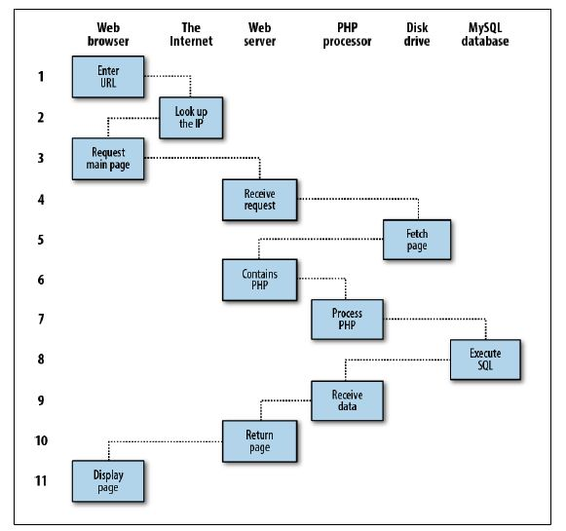
Dynamic webpage request response procedure
12

Slide 13
Request/ response …. Con’t…
1. You enter http://server.com into your browser’s address bar.
2. Your browser looks up the IP address for server.com.
3. Your browser issues a request to that address for the web server’s home page.
4. The request crosses the Internet and arrives at the server.com web server.
5. The web server, having received the request, fetches the home page from its hard disk.
6. With the home page now in memory, the web server notices that it is a file incorporating PHP scripting and passes the page to the PHP interpreter.
13

Slide 14
Request/ response …. Con’t…
7. The PHP interpreter executes the PHP code.
8. Some of the PHP contains MySQL statements, which the PHP interpreter now passes to the MySQL database engine.
9. The MySQL database returns the results of the statements back to the PHP interpreter.
10. The PHP interpreter returns the results of the executed PHP code, along with the results from the MySQL database, to the web server.
11. The web server returns the page to the requesting client, which displays it.
14

Slide 15
PHP – Language Basics
A PHP script always
starts with <?php and
ends with ?>
A PHP script can be placed anywhere in the document.
Syntax
PHP code should enclosed within:
<?php and ?> So that it is distinguished from HTML.
Hence, the PHP parser only parses code which is in between <?php and ?>
PHP code can be embedded in HTML
15

Slide 16
Language Basics (cont’d)…
A PHP file normally contains HTML tags, and some PHP scripting code.
Below, we have an example of a simple PHP script that sends the text "Hello World" back to the browser:
Each code line in PHP must end with a semicolon.
The semicolon is a separator and is used to distinguish one set of instructions from another.
<html> <body> <?php echo "Hello World"; ?>
</body> </html>
16
Notes:
There are two basic statements to output text with PHP: echo and print.
16

Slide 17
Language Basics (cont’d)…
A more complex example:
//Considering $expression=12>13 execute the following code and check the output
<?php if ($expression) { ?>
<strong>This is true.</strong>
<?php
} else {
?>
<strong>This is false.</strong>
<?php
}
?>
17

Slide 18
Language Basics (cont’d)…
Comments in PHP
In PHP, we use // to make a one-line comment or /* and */ to make a comment block:
<html> <body> <?php //This is a comment /* This is a comment block */ ?> </body> </html>
18

Slide 19
Variables in PHP
Variables are used for storing values, such as numbers, strings or function results, so that they can be used many times in a script.
Variables are used for storing a values, like text strings, numbers or arrays.
When a variable is set it can be used over and over again in your script
All variables in PHP start with a $ sign symbol.
19

Slide 20
Variables …
Declaring PHP variable (loosely typed)
Assignment statement is used to create PHP variables.
Syntax
Example
$var_name = value;
<?php
$txt = "Hello World!";
$number = 16;
?>
20

Slide 21
Variable Naming Rules
A variable name must start with a letter or an underscore "_"
A variable name can only contain alpha-numeric characters and underscores (a-Z, 0-9, and _ )
A variable name should not contain spaces.
If a variable name is more than one word,
separated with underscore ($my_string), or
capitalization ($myString)
21

Slide 22
Data types
Boolean (bool or boolean)
Simplest of all
Can be either TRUE or FALSE
Integer (int or integer)
Hold integer values (signed or unsigned)
Floating point (float or double or real)
Hold floating point values
String (string)
Hold strings of characters within either ‘ or ‘’
Escaping of special characters can be done using \
Ex. “this is a string”, ‘this is another string’, “yet \”another\” one”
22

Slide 23
Data types (cont’d)
Array
Collection of values of the same data type
Object
Instance of a class
Resource
Hold a reference to an external resource created by some functions
NULL
Represents that a variable has no value
A variable is considered to be NULL if
it has been assigned the constant NULL.
it has not been set to any value yet.
it has been unset()
23

Slide 24
Type Casting
The casts allowed are:
(int), (integer) - cast to integer
(bool), (boolean) - cast to boolean
(float), (double), (real) - cast to float
(string) - cast to string
(array) - cast to array
(object) - cast to object
24

Slide 25
String in PHP
variable is used to store and manipulate text.
<?php
$txt="Hello World";
echo $txt;
?>
25

Slide 26
String…
The concatenation operator (.) is used to put two string values together
The strlen() function is used to find the length of a string.
<?php
$txt1="Hello World";
$txt2="1234";
echo $txt1 . " " . $txt2;
?>
<?php
echo strlen("Hello world!");
?>
26

Slide 27
String….
The strpos() function is used to search for a string or character within a string
<?php
echo strpos("Hello world!","world");
?>
27

Slide 28
Arithmetic operator
Operator | Description | Example | Result
+ | Addition | $x=2 $x+2 | 4
- | Subtraction | $x=2 5-$x | 3
* | Multiplication | $x=4 $x*5 | 20
/ | Division | 15/5 5/2 | 3 2.5
% | Modulus (division remainder) | 5%2 10%8 10%2 | 1 2 0
++ | Increment | $x=5 $x++ | $x=6
-- | Decrement | $x=5 $x-- | $x=4
28

Slide 29
Assignment operator
Operator | Example | Is The Same As
= | $x=$y | $x=$y
+= | $x+=$y | $x=$x+$y
-= | $x-=$y | $x=$x-$y
*= | $x*=$y | $x=$x*$y
/= | $x/=$y | $x=$x/$y
.= | $x.=$y | $x=$x.$y
%= | $x%=$y | $x=$x%$y
29

Slide 30
Comparison operator
Operator | Description | Example
== | is equal to | 5==8 returns false
!= | is not equal | 5!=8 returns true
> | is greater than | 5>8 returns false
< | is less than | 5<8 returns true
>= | is greater than or equal to | 5>=8 returns false
<= | is less than or equal to | 5<=8 returns true
30

Slide 31
Logical operators
Operator | Description | Example
&& | and | x=6 y=3 (x < 10 && y > 1) returns true
|| | or | x=6 y=3 (x==5 || y==5) returns false
! | not | x=6 y=3 !(x==y) returns true
31

Slide 32
Control structures
Conditional constructs
If … else
if ( condition1 )
{
statements
}elseif ( coditon2 )
{
statements
}
elseif( condition3 )
{
…
}else{
statements
}
32

Slide 33
Control structures (cont’d)
Conditional statement
( condition ) ? True_value : False_value
Example:
…
<?php
$year = (int)date( “Y”);
echo ( $year % 4 == 0 ) ? “Leap Year” : “Not Leap Year”;
?>
…
33

Slide 34
Control structures (cont’d)
Switch
switch ( expression ){
case value 1:
statements
break;
…
case value n:
statements
break;
default:
statements
}
34

Slide 35
Switch…
<?php
$x=2;
switch ($x)
{
case 1:
echo "Number 1";
break;
case 2:
echo "Number 2";
break;
case 3:
echo "Number 3";
break;
default:
echo "No number between 1 and 3";
}
?>
35

Slide 36
Control structures (cont’d)
Looping constructs
while - loops through a block of code if and as long as a specified condition is true
do...while - loops through a block of code once, and then repeats the loop as long as a special condition is true
for - loops through a block of code a specified number of times
foreach - loops through a block of code for each element in an array
36

Slide 37
Control structures (cont’d)…
for loop
for( initialization; condition; increment ){
loop body
}
<html>
<body>
<?php
for ($i=1; $i<=5; $i++)
{
echo "Hello World!<br />";
}
?>
</body>
</html>
37

Slide 38
Control structures (cont’d)…
foreach loop
foreach( array as [key=>]value ){
loop body
}
<html> <body> <?php $x=array("one","two","three"); foreach ($x as $value) { echo $value . "<br>"; } ?> </body> </html>
38
Notes:
38

Slide 39
Example
…
$arr = array(“name”=>”Abebe”, “dept”=>”CS”, “year”=>3, “cgpa”=>3.5);
foreach( $arr as $key=>$value ){
echo $key . “ = “ . $value . “<br>”;
}
//output
name = Abebe
dept = CS
year = 3
cgpa = 3.5
39

Slide 40
Control structures (cont’d)
While loop
while( condition ){
loop body
}
<html>
<body>
<?php
$i=1;
while($i<=5)
{
echo "The number is " . $i . "<br />";
$i++;
}
?>
</body>
</html>
40

Slide 41
do….while
Do-while loop
do{
loop body
}while( condition );
<html>
<body>
<?php
$i=0;
do
{
$i++;
echo "The number is " . $i . "<br />";
}
while ($i<5);
?>
</body>
</html>
41

Slide 42
Control structures (cont’d)
break
ends execution of the current for, foreach, while, do-while or switch structure.
accepts an optional numeric argument which tells it how many nested enclosing structures are to be broken out of.
continue
used within looping structures to skip the current loop iteration
execution continues at the condition evaluation and then the beginning of the next iteration
42

Slide 43
Control structures (cont’d)
return
If called from within a function, the return statement immediately ends execution of the current function, and returns its argument as the value of the function call
If return is called from within the main script file, then script execution ends.
43

Slide 44
Form and php
PHP Forms and User Input
The PHP $_GET and $_POST variables are used to retrieve information from forms, like user input.
PHP Form Handling
The most important thing to notice when dealing with HTML forms and PHP is that any form element in an HTML page will automatically be available to your PHP scripts.
44

Slide 45
Form….
<html>
<body>
<form action=“register.php" method="post">
Name: <input type="text" name="name" />
Age: <input type="text" name="age" />
<input type="submit" />
</form>
</body>
</html>
<html>
<body>
Welcome <?php echo $_POST[‘name’]; ?>.<br />
You are <?php echo $_POST[‘age’]; ?> years old.
</body>
</html>
45

Slide 46
Form …. GET method
<form action=“register.php" method="get">
salary: <input type="text" name=“salary" />
<input type="submit" />
</form>
Welcome <?php echo $_GET[‘name’]; ?>.<br />
You are <?php echo $_GET[‘age’]; ?> years old!
46

Slide 47
Array
An array is a special variable, that can store a set or sequential value
In PHP, there are three kind of arrays:
Numeric array - An array with a numeric index
Associative array - An array where each ID key is associated with a value
Multidimensional array - An array containing one or more arrays
47

Slide 48
Numerically indexed array
stores each array element with a numeric index.
Initializing
$product =array(“tires”, ”oil”, ”mirror”);
or
$product[0]=“tires”;
$product[1]= ”oil”;
$product[2]=”mirror”;
Loop access
for($i=0; i<3; i++)
echo $product[i];
48

Slide 49
Associative array
each ID key or index is associated with a value
we can use values as keys and assign values to them
Initializing
$price =array(“tires”=>100, ”oil”=>10, ”mirror”=>50);
or
$price =array(“tires”=>100);
$price[ ”oil”]=10;
$price[ ”mirror”]=50;
Accessing array elements
echo $price[ ”oil”];
49

Slide 50
Accessing array elements
foreach($price as $key => $value){
echo $key . “-”. $value. “<br>”;
}
while($element = each($price)){
echo $element[key];
echo “-”;
echo $element[value];
echo “<br>”
}
while(list( $product, $price)= each($price)){
echo “$product - $price <br>”;
}
50

Slide 51
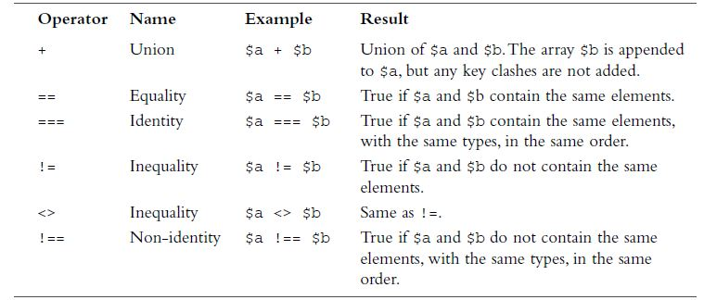
Array operators
51

Slide 52
Multidimensional array
each element in the main array can also be an array
Code | Description | Price
TIR | tires | 100
OIL | Oil | 10
MIR | Mirror | 50
$product =array( array( ‘code’ =>’TIR’
description=>’tires’
price=>’100’),
array( ‘code’ =>’OIL’
description=>’oil’
price=>’10’),
array( ‘code’ =>’MIR’
description=>’mirror’
price=>’50’)
);
52

Slide 53
Accessing element of MD array
for($rows=0; $rows<3; $rows++){
echo “|”. $product[($rows][$code] . “-”. $product[($rows][$description] . “-”. $product[($rows][$price] . “|”. “<BR/>”;
}
53

Slide 54
Functions in PHP
A function is a self contained module of code that prescribe a calling interface, performs some task and optionally return a result
Function declaration
function functionName(parameter1, parameter2…){
Function body….
return
}
54

Slide 55
Example 1 : calling function
<html> <body> <?php function Sum($x, $z) { echo “the sum is= ”. $x+$z<br />"; } ?>
<h1>add two numbers</h1>
<?php Sum(4,6);// calling the function ?> </body> </html>
55

Slide 56
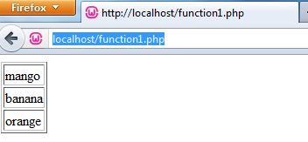
Example 2: passing value to function
<?php
function createTable($data)
{
echo "<table border=\"1\">";
reset($data);
$value=current($data);
while($value){
echo "<tr><td>".$value."</td></tr>\n";
$value=next($data);
}
echo "</tabel>";
}
?>
<?php
$sampleArray = array("mango",
"banana",
"orange");
createTable($sampleArray);
?>
Passing argument to function
Output
56
Notes:
<html>
<body>
<?php
function createTable($data)
{
echo "<table border=\"1\">";
reset($data);
$value=current($data);
while($value){
echo "<tr><td>".$value."</td></tr>\n";
$value=next($data);
}
echo "</tabel>";
}
?>
<?php
$sampleArray = array("mango", "banana", "orange");
createTable($sampleArray);
?>
</body>
</html>
56

Slide 57
Reading assignment
Read the following concepts in PHP
Passing by value
Passing by reference
Recursive function
Namespaces
57

Slide 58
Database manipulation using PHP

Slide 59
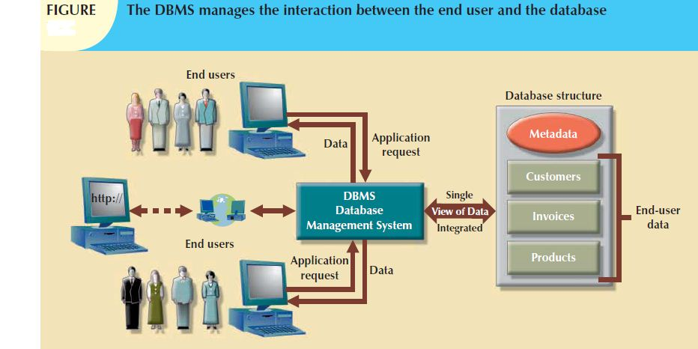
1
Review on Database terms
Database: is a collection of related data
Database Management System (DBMS): A software package/ system to facilitate the creation and maintenance of a computerized database.
Software to process queries
+
Software to access data

Slide 60
Relational DataBase Management System (RDBMS)
Enables you to implement a database with tables, columns and indexes.
Guarantees the Referential Integrity between rows of various tables.
Updates the indexes automatically.
Interprets an SQL query and combines information from various tables

Slide 61
RDBMS Terminology:
Database: A database is a collection of tables, with related data.
Table: A table is a matrix with data
Column: One column (data element) contains data of one and the same kind, to represent one property of an entity
Row: A row (= tuple, entry or record) is a group of related data, to represent one instance of an entity
Redundancy: Storing data twice, redundantly to make the system faster.
Primary Key: A primary key is unique. A key value can not occur twice in one table. With a key, you can find at most one row.
Foreign Key: A foreign key is the linking pin between two tables
Constraints: rules set over database elements

Slide 62
Introduction to MySQL
MySQL is a RDBMS
Is an open-source software
Use standard form of SQL data language
supports large databases, up to 50 million rows or more in a table
The MySQL command line monitor Creating database tables Queries
Notes:
MySQL supports large databases, up to 50 million rows or more in a table. The default file size limit for a table is 4GB, but you can increase this (if your operating system can handle it) to a theoretical limit of 8 million terabytes (TB).
•

Slide 63
Basic queries
CREATE: create databases and tables
CREATE TABLE tableName(columnName Datatype constraint, …. );
SELECT: select table rows based on certain conditions
SELECT columnName, columnName… FROM tableName WHRER condition;
DELETE: delete one or more rows of a table
DELETE FROM tableName WHERE condition;
INSERT: insert a new row in a table
INSERT INTO tableName(column list) VALUES (column values);
UPDATE: update rows in a table
UPDATE tableName SET columnName = NewValues;
ALTER: alter the structure of a table
ALTER TABLE tableName ADD columnBame dataType;
ALTER TABLE tableName DROP columnName;
ALTER TABLE tableName MODIFY columnName Datatype [NULL value] [DEFAULT value];
ALTER TABLE tableName CHANGE old_columnName new_columnName datatype;
ALTER TABLE tableName RENAME TO new_tableName;

Slide 64
Administrative MySQL Command:
USE Databasename: This will be used to select a particular database in MySQL work area.
SHOW DATABASES: Lists the databases that are accessible by the MySQL DBMS.
SHOW TABLES: Shows the tables in the database once a database has been selected with the use command.
SHOW COLUMNS FROM tablename: Shows the attributes, types of attributes, key information, whether NULL is permitted, defaults, and other information for a table.
SHOW INDEX FROM tablename: Presents the details of all indexes on the table, including the PRIMARY KEY.
SHOW TABLE STATUS LIKE tablename\G: Reports details of the MySQL DBMS performance and statistics.

Slide 65
PHP and MySQL functions
Connecting to a Database
Making a query
Using results of a query
Freeing resources
closing the connection

Slide 66
Connecting to a Database
$servername=“servername:port";
$username=“mysql_user_name“;
$password=“mysql_password";
$dbname=“database_name“;
$con = mysqli_connect($servername, $username, $password, $dbname);
Opens a new connection MySQL server
$servername can be either a host name or an IP address
the default is the string "localhost:3306"
username is a string for the user name
password is a string for the password
dbname is the name of the database to connect with
returns FALSE on failure

Slide 67
Example PHP for DB connection
<?php
function connect_db($dbname){
$con = mysqli_connect("localhost:3306", "root", "", $dbname);
if(mysqli_connect_errno()){
echo "Connection failed: " . mysqli_connect_error();
}
return $con;
}
?>

Slide 68
Making a query (1. SELECT)
$query="SELECT SID, StudName, age, sex FROM student";
$result=mysqli_query($con, $query);
This task involve preparing a query and submitting it to the database engine for retrieval
$con is the connection string
query is a string for the MySQL query
It makes a select query
Don't end the query with a semi-colon
Return value is a resource identifier or FALSE if the query is SELECT or SHOW

Slide 69
Making a query (2. INSERT and UPDATE)
for these queries a resource is not returned
TRUE is returned on success
FALSE is returned on failure
Syntax rules to follow:
The SQL query must be quoted in PHP
String values inside the SQL query must be quoted
Numeric values must not be quoted
The word NULL must not be quoted
$sql1 = "INSERT INTO student (StudName, age, sex, SID) VALUES ('$studname', '$age', '$sex', '$sid')";
$sql2= “UPDATE student SET StudName='$studname', age='$age', sex='$sex‘ WHERE SID='$sid‘ ";

Slide 70
Using the query result
Involves two subsequent tasks
Identify the number of rows affected by the query
Fetch the data from the database server
In this step, we can iterate through the result and display the record in a certain format. Example: in a tabular format
$row=mysqli_num_rows($result);//number of rows
$row_record=mysqli_fetch_row()
/*each call returns the next row as an indexed array where result is a resource returned from a call to mysqli_query (FALSE if no more rows)*/
$row_record=mysqli_fetch_assoc($result);//record set
/*as in mysql_fetch_row but next row is returned as an associative array*/
$row_record=mysqli_fetch_array(result)
/*combines mysqli_fetch_row, mysqli_fetch_assoc
returns row information as both an associative array and an indexed array*/

Slide 71
Example PHP for DB query (SELECT)
<?php
function viewData($dbname){
$dbname= $dbname;
$con = connect_db($dbname);
$sql = "SELECT SID, StudName, age, sex FROM student";
$result=mysqli_query($con, $sql);
if(mysqli_num_rows($result)>0){
echo "<table border='1'><th>ID</th><th>NAME</th><th>AGE</th><th>SEX</th>";
while($row=mysqli_fetch_assoc($result)){
echo "<tr><td>".$row["SID"]."</td><td>".$row["StudName"]."</td><td>".$row["age"]."</td><td>".$row["sex"]."</td></tr>";
}
echo "</table>";
}
else{
echo "no record found";
}
}
?>

Slide 72
Freeing query resources
mysqli_free_result($result)
free memory associated with the given resource
called result (after a select query).
Not necessary except for large result sets
Done automatically when script exits.

Slide 73
closing the connection
mysqli_close($con)
close the database connection associated with the given database link, ($con).

Slide 74
Error handling
mysqli_connect_errno()
Returns the last error code number from the last call to mysqli_connect
An error code value for the last call to mysqli_connect, if it failed.
zero means no error occurred
mysqli_connect_error
Returns a string description of the last connect error
NULL is returned if no error occurred.

Slide 75
Other functions
mysqli_real_escape_string($con, $ escapeString);
This function is used to create a legal SQL string that you can use in an SQL statement.
The given string is encoded to an escaped SQL string, taking into account the current character set of the connection.
parameters
$con: a link identifier returned by mysqli_connect
$escapeString: the string to be escaped.
Characters encoded are NUL (ASCII 0), \n, \r, \, ', ", and Control-Z.

Slide 76
Student register example
First create a database and the table
CREATE DATABASE sampledb;
USE sampledb;
CREATE TABLE student
(
SID int PRIMARY KEY NOT NULL AUTOINCREMENT,
studName varchar(50),
sex varchar(10),
age int
);

Slide 77
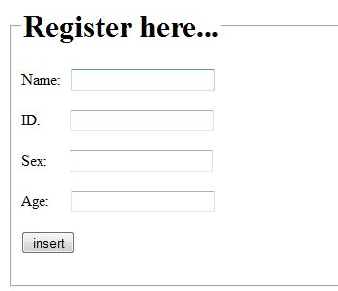
Insert.html (insert.php)
<html>
<body>
<fieldset>
<legend><h1>Register here...</h1></legend>
<form action="register.php" method="post">
Name: &nbsp; <input type="text" name="name"><br><br>
ID:&tbsp; &nbsp; &nbsp; &nbsp; <input type="text" name="id"><br><br>
Sex:&nbsp; &nbsp; &nbsp; <input type="text" name="sex"><br><br>
Age:&nbsp; &nbsp; &nbsp; <input type="text" name="age"><br><br>
<input type="submit" value="insert"><br><br>
</form>
</fieldset>
</body>
</html>

Slide 78
Register.php
<?php
$studname= mysqli_real_escape_string($con, $_POST['name']);
$age=mysqli_real_escape_string($con, $_POST['age']);
$sex=mysqli_real_escape_string($con, $_POST['sex']);
$sid=mysqli_real_escape_string($con, $_POST['id']);
$sql = "INSERT INTO student (StudName, age, sex, SID) VALUES ('$studname', '$age', '$sex', '$sid')";
if (!mysqli_query($con, $sql)) {
$err=1;
}
mysqli_close($con);
if(isset($err)){
header("location: index.html?err=1");
}
else{
header("location: index.html");
}
?>

Slide 79
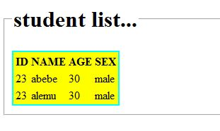
View.php
<?php require_once('connect_db.php')?>
<html>
<body>
<?php
$dbname="sampledb";
$con = connect_db($dbname);
$sql = "SELECT SID, StudName, age, sex FROM student";
$result=mysqli_query($con, $sql);
if(mysqli_num_rows($result)>0){
echo "<table border='1'><th>ID</th><th>NAME</th><th>AGE</th><th>SEX</th>";
while($row=mysqli_fetch_assoc($result)){
Echo"<tr><td>".$row["SID"]."</td><td>".$row["StudName"]."</td><td>".$row["age"]."</td><td>".$row["sex"]."</td></tr>";
}
echo "</table>";
}
else{
echo "no record found";
}
mysqli_close($con);
?>
</body></html>

Slide 80
Sessions and Cookies management in PHP

Slide 81
Topics
What are cookies?
Create and use cookies.
What are sessions?
Create and use sessions
81
Sessions and Cookies management in PHP

Slide 82
Introduction
HTTP is a stateless protocol.
A stateless protocol does not require the server to retain information or status about each user for the duration of multiple requests.
this means that after an exchange is over...
a browser requests a resource from a server
the web server sends the resource to the browser
...the connection will be closed and forgotten
this has its advantages
because there is nothing to be kept track of, it is relatively easy to build web servers that are very efficient
But also it has drawbacks
it makes it hard to follow a user on a website
82
Sessions and Cookies management in PHP

Slide 83
Why to follow a user’s?
It is often extremely useful to be able to follow a user’s activities on a website so that one can for example
have a shopping cart
maintain the user’s identity
display information specifically tailored to the individual user
Increased ability to provide the user a richer experience of using that website
a fine example of a site that truly exploits the user’s identity is Amazon, which in many ways has set the standard in the application of user identity to provide a rich experience
83
Sessions and Cookies management in PHP

Slide 84
…
Login
Another aspect is the ability to log into a site with username and password
this provides some level of security
One gets the opportunity to have “your own” page
with personal things, like your own photos on Facebook
a personal configuration of the page
a user identity for postings on web boards
etc.
84
Sessions and Cookies management in PHP

Slide 85
Some of the scenarios do not need to know “who” you are
“a specific browser on a particular machine” is often enough
here we often talk about the temporary nature of information
In other situations it is useful to know “who” people are
one can get a more personalized experience of the site (this helps perhaps also with loyalty)
one can log on from different machines and have the same user experience
85
Sessions and Cookies management in PHP

Slide 86
So what can we do?
One can add a parameter to the URL and remember it so that all subsequent links on the site contain it
but that gives ugly URLs that are difficult to maintain (one always has to rewrite all the URLs in a document) and
are vulnerable to trivial hacks
Since the web server can see, where a request comes from, one could use the user’s machine address as an ID
but what if it is a shared computer?
or if it just looks like one computer due to NAT or a proxy?
It would be great if a website could save a little bit of data on the user’s machine ...
86
Sessions and Cookies management in PHP

Slide 87
So…
So, web applications need to track the user's progress from page to page, for example when a web server is required to customize the content of a web page for a user.
Solutions to address the above mentioned problems are cases that include:
the use of HTTP cookies.
server side sessions,
hidden variables (when the current page contains a form), and
URL-rewriting using URI-encoded parameters, e.g., /index.php?session_id=some_unique_session_code.
87
Sessions and Cookies management in PHP

Slide 88
Solution…
HTTP remains stateless – there is no fixed connection between web server and browser
While the stateless nature of HTTP has some important benefits
after all, maintaining state requires some overhead
it presents a unique challenge to developers who need to create state-full web applications.
With no way to identify the client, it is impossible to determine
whether the user is already logged in,
has items in a shopping cart, or needs to register.
An elegant solution to this problem, originally conceived by Netscape, is a state management mechanism called cookies.
88
Sessions and Cookies management in PHP

Slide 89
Cookies
a web server can leave a “cookie” in the browser (i.e. on the user’s computer)
it is up to the browser to manage these cookies
the cookie gets transmitted to the server in future connections
A cookie is a small piece of data (typically max 4 KB, usually far less) that is used by the web server to identify the user
Cookies may be limited in time with an expiration date
else the cookie will be deleted when the browser is closed
89
Sessions and Cookies management in PHP

Slide 90
Cookies
are an extension of the HTTP protocol.
they consist of two HTTP headers:
the Set-Cookie response header and
the Cookie request header.
When a client sends a request for a particular URL, the server can opt to include a Set-Cookie header in the response, so as to request for the client to include a corresponding Cookie header in its future requests
Cookies
allow a unique identifier to be included in each request (in a Cookie header),
This help to uniquely identify clients and associate their requests together.
90
Sessions and Cookies management in PHP

Slide 91
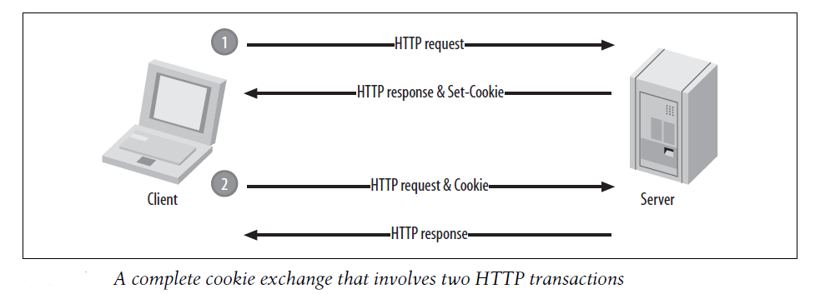
91
Sessions and Cookies management in PHP

Slide 92
Create Cookies in PHP
Use setcookie() function to create a cookie.
Syntax
setcookie(string name, string value, int expire, string path, string domain, int secure);
Example:
<?php
// Setting a cookie
setcookie("username", “Abebe", time()+10*24*60*60);
?>
92
Sessions and Cookies management in PHP

Slide 93
Parameter | Description
name | The name of the cookie.
value | The value of the cookie.
expires | The expiry date in UNIX timestamp format. This implies, After this time cookie will become inaccessible. The default value is 0.
path | Specify the path on the server for which the cookie will be available. If set to '/', the cookie will be available within the entire domain.
domain | Specify the domain for which the cookie is available to e.g www.example.com.
secure | This field, if present, indicates that the cookie should be sent only if a secure HTTPS connection exists. Is a Keyword referring that the cookie will not be sent over a plain HTTP connection
93
Sessions and Cookies management in PHP

Slide 94
Accessing cookie
The PHP $_COOKIE super global variable is used to retrieve a cookie value.
<html>
<head><title>sample on cookie</title></head>
<body>
<?php
if(!isset($_COOKIE["username"]))
{
setcookie("username", "Abebe", time()+10*24*60*60);
}
else{
echo $_COOKIE["username"]; // used to access a cookie
}?>
</body>
</html>
94
Sessions and Cookies management in PHP
Notes:
It typically an associative array that contains a list of all the cookies values sent by the browser in the current request, keyed by cookie name. The individual cookie value can be accessed using standard array notation,
94

Slide 95
Check if Cookies are Enabled
count the $_COOKIE array variable
<?php
setcookie("username", "Abebe", time()+10*24*60*60);
?>
<html>
<body>
<?php
if(count($_COOKIE) > 0) {
echo "Cookies are enabled.";
} else {
echo "Cookies are disabled.";
}
?>
</body>
</html>
95
Sessions and Cookies management in PHP

Slide 96
Removing Cookies
Cookies can be deleted by calling the setcookie() function with the cookie name and any value (such as an empty string) with expiration date set in the past,
<?php
// Deleting a cookie
setcookie("username", "", time()-3600);
?>
96
Sessions and Cookies management in PHP

Slide 97
Scope of cookies
Cookies can only be read from the site from which they were set
this helps to ensure that one can not steal cookies (and thus identities) through hostile websites
97
Sessions and Cookies management in PHP

Slide 98
Cookies and their use
Shopping cart
when the front page appears, set a new (empty) cookie
items are added by updating the cookie
alternatively, one can store goods in the server’s database and just store an ID in the cookie that points to your basket
Login
user inputs name and password into a form
after the combination has been verified, it sends a cookie to the user that identifies the user to the system
next time the user visits the page, the web server checks if there is a cookie, and if so the user is identified
98
Sessions and Cookies management in PHP
Notes:
Although you can store data using cookies but it has some security issues. Since cookies are stored on user's computer it is possible for an attacker to easily modify a cookie content to insert potentially harmful data in your application that might break your application.
Also every time the browser requests a URL to the server, all the cookie data for a Web site is automatically sent to the server within the request. It means if you have sotored 5 cookies on user's system, each having 4KB in size, the browser needs to upload 20KB of data each time the user views a page, which can affect your site's performance.
98

Slide 99
Criticism of cookies
One can not be completely anonymous on the net
most ads/banners come from relatively few advertisers.
these may, with the help of cookies, follow a browser/ computer combination on all the sites they advertise on.
there have been examples of security vulnerabilities in browsers, so that adversaries can get access to cookies
which they can use to gain access to sites with a faked identity
99
Sessions and Cookies management in PHP
Notes:
Although you can store data using cookies but it has some security issues. Since cookies are stored on user's computer it is possible for an attacker to easily modify a cookie content to insert potentially harmful data in your application that might break your application.
Also every time the browser requests a URL to the server, all the cookie data for a Web site is automatically sent to the server within the request. It means if you have sotored 5 cookies on user's system, each having 4KB in size, the browser needs to upload 20KB of data each time the user views a page, which can affect your site's performance.
99

Slide 100
Sessions
A combination of cookies and data stored on the server (automatically by PHP)
saves a cookie containing an ID on the user’s computer that points to a session on the server
A session is a global PHP array ($_SESSION)
A session is designed as an easy way to store data – for a short period
a session’s lifetime in PHP is only 24 minutes by default
100
Sessions and Cookies management in PHP

Slide 101
Starting PHP session
Sessions must be started at the top of the page before it is used
session_start()
Session_start() function creates a new session and generate a unique session ID for the user.
it first checks for an existing session ID. If it finds one, i.e. if the session is already started, it sets up the session variables and if doesn't, it starts a new session by creating a new session ID.
101
Sessions and Cookies management in PHP

Slide 102
Storing and Accessing Session Data
session data can be stored as key-value pairs in the $_SESSION[] super global array.
The stored data can be accessed during lifetime of a session.
<?php
// Starting session
session_start();
// Storing session data
$_SESSION["firstname"] = “Abebe";
$_SESSION["lastname"] = “Lemlem";
?>
102
Sessions and Cookies management in PHP
Notes:
then one can access the $_SESSION array
102

Slide 103
Accessing session data
We can access the session data we set on our previous example from any other page on the same web domain
Simply recreate the session by calling session_start() and then pass the corresponding key to the $_SESSION associative array.
<?php
session_start();
echo $_SESSION["Name"];
?>
103
Sessions and Cookies management in PHP

Slide 104
Destroying PHP session
all global session variables can be removed by destroing the session using
session_unset(“sessionId”) //remove all session variables
session_destroy():// destroy the session
<?php
session_start();
// Removing session data
if(isset($_SESSION[“username"])){
session_unset($_SESSION[“username"]);
}
?>
<?php
session_start();
// Destroying session
session_destroy();
?>
104
Sessions and Cookies management in PHP

Slide 105
Session for login
Sessions are tied to an individual user and a corresponding browser
therefore, they are well suited to handle logins
Useful command in this context: header()
header() is used to send HTTP headers to the browser
as other header information (such as cookies and sessions), such a command should precede any HTML in a PHP file
a particularly interesting header in this context is Location:, which redirects the browser to another URL
105
Sessions and Cookies management in PHP

Slide 106
Topics
Opening files Writing to a file
Locking a file Reading a file content
Handling file upload
Working with directories
106

Slide 107
Creating a file
The fopen() function is also used to create a file.
Syntax
fopen(filename, mode);
Example
$myfile = fopen("c:/testfile.txt", "w");
<?php
$handle = fopen(“c:/data.txt", "r") or die("Unable to open file!"); ?>
107

Slide 108
Modes | What it does
r | Opens the file for reading only.
r+ | Opens the file for reading and writing.
w | Opens the file for writing only and clears the contents of file. If files does not exist then it attempts to create a file.
w+ | Opens the file for reading and writing and clears the contents of file. If files does not exist then it attempts to create a file.
a | Append. Opens the file for writing only. Preserves file content by writing to the end of the file. If files does not exist then it attempts to create a file.
a+ | Read/Append. Opens the file for reading and writing. Preserves file content by writing to the end of the file. If files does not exist then it attempts to create a file.
x | Opens the file for writing only. Returns FALSE and an error if file already exists.
x+ | Opens the file for reading and writing. Returns FALSE and an error if file already exists.
108

Slide 109
Closing a File with fcolse() Function
Once you've finished working with a file, it needs to be closed.
The fclose() function is used to close the file,
Syntax
fclose($handle);
<?php
$file = "data.txt"; // Open the file for reading
$handle = fopen($file, "r") or die("Cannot open the file");
// Some code to be executed
fclose($handle); // Closing the file handle
?>
109

Slide 110
PHP Read File - fread()
The fread() function reads from an open file.
Syntax
fread(file handle, length in bytes);
Parameters
fread() contains the name of the file to read from
second parameter specifies the maximum number of bytes to read
<?php
$file = "data.txt";
$handle = fopen($file, "r") or die("ERROR: Cannot open the file");
// Read in the entire file
$content = fread($handle,"20");
fclose($handle);
// Display the file content
echo $content;
?>
110

Slide 111
Read entire file
<?php
$file = "data.txt";
// Open the file for reading
$handle = fopen($file, "r") or die("ERROR: Cannot open the file");
// Reading the entire file
$content = fread($handle, filesize($file));
// Closing the file handle
fclose($handle);
// Display the file content
echo $content;
?>
111

Slide 112
Writing the Files Using PHP
You can write data to a file or append to an existing file using the PHP fwrite() function.
Syntax
fwrite(file handle, vstring)
parameter
First: contains the name of the file to write to and the
Second: the string to be written.
112

Slide 113
fwrite()…
<?php
$file = “c:/note.txt";
// String of data to be written
$data = "The quick brown fox jumps over the lazy dog.";
$handle = fopen($file, "w") or die("ERROR: Cannot open the file");
// Write data to the file
fwrite($handle, $data) or die ("ERROR: Cannot write the file");
fclose($handle);
echo "Data written to the file successfully";
?>
113

Slide 114
Overview of PHP file system function
Function | Description
fread() | Reads a string of characters from a file.
fwrite() | Writes a string of characters to a file.
fgetc() | Reads a single character at a time.
feof() | Checks to see if the end of the file has been reached.
fgets() | Reads a single line at a time.
fgetcsv() | Reads a line of comma - separated values.
file() | Reads an entire file into an array.
file_get_contents() | Reads an entire file into a string without needing to open it.
file_put_contents() | Writes a whole string to a file without needing to open it.
fpassthru() | Displays the contents of an open file.
readfile() | Displays the contents of a file without needing to open it.
fseek() | Moves the file pointer to a specific location within an open file.
ftell() | Returns the position of the file pointer.
rewind() | Moves the file pointer to the start of the file.
114

Slide 115
Handling file upload
Uploading file is one of the most common feature which we normally use in our daily life.
We do upload pictures on Facebook, Twitter and other websites.
Allowing file uploads should be done with careful.
To allow file uploads, we need to ensure that PHP is configured.
To configure PHP, in your "php.ini" file search for the file_uploads directive, and set it to On: file_uploads = On
We need an HTML form with one input field with file type, action tag set to the URL of PHP script file that perform the uploading task, and enctype=“multipart/form-data” property in the form to allow file upload

Slide 116
Handling file upload- Create The HTML Form
<!DOCTYPE html> <html> <body> <form action="upload.php" method="post" enctype="multipart/form-data"> Select image to upload: <input type="file" name="fileToUpload" id="fileToUpload"> <input type="submit" value="Upload Image" name="submit"> </form> </body> </html>

Slide 117
Handling file upload- Rules to follow for the HTML form
Without the following requirements file upload will not work.
Make sure that the form uses method="post”.
The form also needs the following attribute: enctype="multipart/form-data” that indicates which content-type to use when submitting the form
The type="file" attribute of the <input> tag shows the input field as a file-select control, with a "Browse" button next to the input control
The form in previous slide sends data to a file called "upload.php”.

Slide 118
Handling file upload- Upload File PHP Script
<?php $target_dir = "uploads/"; $target_file = $target_dir . basename($_FILES["fileToUpload"]["name"]); $uploadOk = 1; $imageFileType = strtolower(pathinfo($target_file,PATHINFO_EXTENSION)); // Check if image file is a actual image or fake image if(isset($_POST["submit"])) { $check = getimagesize($_FILES["fileToUpload"]["tmp_name"]); if($check !== false) { echo "File is an image - " . $check["mime"] . "."; $uploadOk = 1; } else { echo "File is not an image."; $uploadOk = 0; } } ?>

Slide 119

PHP script explained:
$target_dir = "uploads/" - specifies the directory where the file is going to be placed
$target_file specifies the path of the file to be uploaded
$uploadOk=1 is not used yet
$imageFileType holds the file extension of the file (in lower case)
Next, check if the image file is an actual image or a fake image
A new directory called "uploads" in the directory where "upload.php" file resides needs to be created. The uploaded files will be saved there.

Slide 120
Add some restrictions
Check if File Already Exists- to check if the file already exists in the "uploads" folder.
// Check if file already exists
if (file_exists($target_file)) {
echo "Sorry, file already exists.";
$uploadOk = 0;
}
Limit File Size- to check the size of the file name “fileToUpload” with the file input field in our HTML form.
// Check file size
if ($_FILES["fileToUpload"]["size"] > 500000) {
echo "Sorry, your file is too large.";
$uploadOk = 0;
}
Limit File Type- allows users to upload JPG, JPEG, PNG, and GIF files.
// Allow certain file formats if($imageFileType != "jpg" && $imageFileType != "png" && $imageFileType != "jpeg" && $imageFileType != "gif" ) { echo "Sorry, only JPG, JPEG, PNG & GIF files are allowed."; $uploadOk = 0; }

Slide 121
Complete Upload File PHP Script
<?php
$target_dir = "uploads/";
$target_file = $target_dir . basename($_FILES["fileToUpload"]["name"]);
$uploadOk = 1;
$imageFileType = strtolower(pathinfo($target_file,PATHINFO_EXTENSION));
// Check if image file is a actual image or fake image
if(isset($_POST["submit"])) {
$check = getimagesize($_FILES["fileToUpload"]["tmp_name"]);
if($check !== false) {
echo "File is an image - " . $check["mime"] . ".";
$uploadOk = 1;
} else {
echo "File is not an image.";
$uploadOk = 0;
}
}
// Check if file already exists
if (file_exists($target_file)) {
echo "Sorry, file already exists.";
$uploadOk = 0;
}

Slide 122
Complete Upload File PHP Script cont’d…
// Check file size
if ($_FILES["fileToUpload"]["size"] > 500000) {
echo "Sorry, your file is too large.";
$uploadOk = 0;
}
// Allow certain file formats
if($imageFileType != "jpg" && $imageFileType != "png" && $imageFileType != "jpeg"
&& $imageFileType != "gif" ) {
echo "Sorry, only JPG, JPEG, PNG & GIF files are allowed.";
$uploadOk = 0;
}
// Check if $uploadOk is set to 0 by an error
if ($uploadOk == 0) {
echo "Sorry, your file was not uploaded.";
// if everything is ok, try to upload file
} else {
if (move_uploaded_file($_FILES["fileToUpload"]["tmp_name"], $target_file)) {
echo "The file ". htmlspecialchars( basename( $_FILES["fileToUpload"]["name"])). " has been uploaded.";
} else {
echo "Sorry, there was an error uploading your file.";
}
}
?>

Slide 123
Handling file upload- Example 2
HTML form to upload file
<form name="form" method="post" action="upload.php" enctype="multipart/form-data" >
<input type="file" name="my_file" /><br /><br />
<input type="submit" name="submit" value="Upload"/>
</form>

Slide 124
Handling file upload- Example 2
<?php
if(($_FILES["my_file"]["name"]!="")){
// Where the file is going to be stored
$target_dir ="upload/";
$file = $_FILES['my_file']['name'];
$path = pathinfo($file);
$filename = $path['filename'];
$ext = $path['extension'];
$temp_name = $_FILES['my_file']['tmp_name'];
$path_filename_ext = $target_dir.$filename.".".$ext;
// Check if file already exists
if (file_exists($path_filename_ext)) {
echo "Sorry, file already exists.";
}else{
move_uploaded_file($temp_name,$path_filename_ext);
echo "Congratulations! File Uploaded Successfully.";
}
}
?>

Slide 125
Working with directories
PHP provides a number of functions that can be used to perform tasks such as identifying and changing the current directory, creating new directories, deleting existing directories and listing the contents of a directory.
A new directory can be created in PHP using the mkdir() function, which takes a path to the directory to be created.
To create a directory in the same directory as your PHP script simply provide the directory name.
To create a new directory in a different directory specify the full path when calling mkdir().
Syntax: mkdir(path, mode, recursive, context)

Slide 126
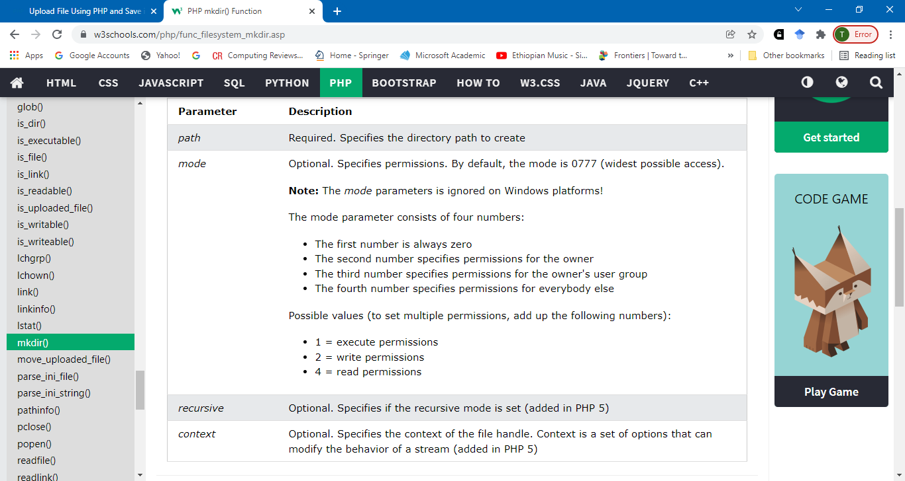
PHP mkdir() Function
mkdir(path, mode, recursive, context)

Slide 127
Working with directories
A second, optional argument allows the specification of permissions on the directory (controlling such issues as whether the directory is writable):
<?php
mkdir ("directory");
?>
Deleting a Directory
Directories are deleted in PHP using the rmdir() function.
rmdir() takes a single argument, the name of the directory to be deleted.
The deletion will only be successful if the directory is empty.
If the directory contains files or other sub-directories the deletion cannot be performed until those files and sub-directories are also deleted.
<?php
rmdir ("directory");
?>

Slide 128
Finding and Changing the Current Working Directory
It is unlikely that a web application will be able to perform all of its file related tasks in a single directory.
For this reason, it is vital to be able to both find out the current working directory, and change to another directory from within a PHP script.
The current working directory can be identified using the getCwd() function:
<?php
$current_dir = getCwd();
echo "Current directory is $current_dir";
?>

Slide 129
Change current working directory: chdir() function
chdir() takes as the only argument the path of the new directory:
<?php
$current_dir = getCwd();
echo "Current directory is $current_dir <br>";
chdir ("tmp");
$current_dir = getCwd();
echo "Current directory is now $current_dir <br>";
?>
“tmp” folder should be created inside current directory

Slide 130
Listing Files in a Directory
The files in a directory can be read using the PHP scandir() function.
scandir() takes two arguments.
The first argument is the path the directory to be scanned.
The second optional argument specifies how the directory listing is to be sorted.
If the argument is 1 the listing is sorted reverse-alphabetically. If the argument is omitted or set to 0 the list is sorted alphabetically:
<?php
chdir ("tmp");
$current_dir = getCwd();
echo "Current directory is now $current_dir";
$array = scandir(".", 1);
print_r($array);
?>

Slide 131
Web service
Why web service ?
Web services allow various applications to talk to each other and share data and services among themselves.
Other applications can also use the web services. For example, a VB or .NET application can talk to Java web services and vice versa.
Web services are used to make the application platform and technology independent.
Web services have the following special behavioural characteristics
XML-Based
Loosely Coupled
Coarse-Grained
Supports Remote Procedure Calls(RPCs)

Slide 132
Application Programming Interface (API)
Application Programming Interface (API) is a software interface that allows two applications to interact with each other without any user intervention.
API is a collection of software functions and procedures. In simple terms, API means a software code that can be accessed or executed.
API is defined as a code that helps two different software's to communicate and exchange data with each other.
It allows the user or a company to customize the content and services which they use the most.

Slide 133
Web Services Architecture
Every framework needs some sort of architecture to make sure the entire framework works as desired, similarly, in web services. The Web Services Architecture consists of three distinct roles as given below :
Provider - The provider creates the web service and makes it available to client application who want to use it.
Requestor - A requestor is nothing but the client application that needs to contact a web service. The client application can be a .Net, Java, or any other language based application which looks for some sort of functionality via a web service.
Broker - The broker is nothing but the application which provides access to the UDDI.
The diagram below showcases how the Service provider, the Service requestor and Service registry interact with each other.

Slide 134
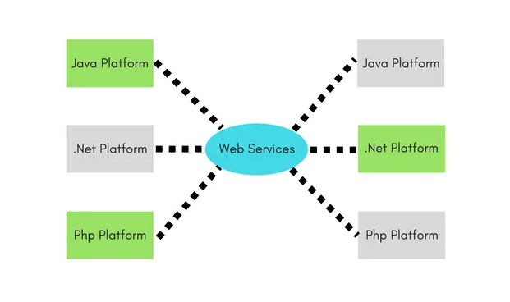
Web Services Architecture
web Services are client and server applications that communicate over the World Wide Web's (WWW) Hypertext Transfer Protocol (HTTP).

Slide 135
Web Services Description Language
WSDL stands for Web Services Description Language.
It is the standard format for describing a web service. WSDL was developed jointly by Microsoft and IBM.
Features of WSDL
WSDL is an XML-based protocol for information exchange in decentralized and distributed environments.
WSDL definitions describe how to access a web service and what operations it will perform.
WSDL is a language for describing how to interface with XML-based services.
WSDL is an integral part of Universal Description, Discovery, and Integration (UDDI), an XML-based worldwide business registry.
WSDL is the language that UDDI uses.
WSDL is pronounced as 'wiz-dull' and spelled out as 'W-S-D-L'.

Slide 136
WSDL document
WSDL document contains the following elements −
Definition − It is the root element of all WSDL documents. It defines the name of the web service, declares multiple namespaces used throughout the remainder of the document, and contains all the service elements described here.
Data types − The data types to be used in the messages are in the form of XML schemas.
Message − It is an abstract definition of the data, in the form of a message presented either as an entire document or as arguments to be mapped to a method invocation.
Operation − It is the abstract definition of the operation for a message, such as naming a method, message queue, or business process, that will accept and process the message.
Port type − It is an abstract set of operations mapped to one or more end-points, defining the collection of operations for a binding; the collection of operations, as it is abstract, can be mapped to multiple transports through various bindings.
Binding − It is the concrete protocol and data formats for the operations and messages defined for a particular port type.

Slide 137
Web Services - SOAP
SOAP (Simple Object Access Protocol)
It is an XML-based messaging protocol for exchanging information among computers.
SOAP is a communication protocol designed to communicate via Internet.
SOAP can extend HTTP for XML messaging.
SOAP provides data transport for Web services.
SOAP can exchange complete documents or call a remote procedure.
SOAP can be used for broadcasting a message.
SOAP is platform- and language-independent.
SOAP is the XML way of defining what information is sent and how.
SOAP enables client applications to easily connect to remote services and invoke remote methods.

Slide 138
Web Services - SOAP
A SOAP message is an ordinary XML document containing the following elements.
Envelope − Defines the start and the end of the message. It is a mandatory element.
Header − Contains any optional attributes of the message used in processing the message, either at an intermediary point or at the ultimate end-point. It is an optional element.
Body − Contains the XML data comprising the message being sent. It is a mandatory element.
Fault − An optional Fault element that provides information about errors that occur while processing the message.

Slide 139
Web Services - REST
The REST stands for Representational State Transfer. REST is not a set of standards or rules, rather it is a style of software architecture.
The applications which follow this architecture are referred to as RESTful
Unlike SOAP which targets the actions, REST concerns more on the resources. REST locates the resources by using URL and it depends on the type of transport protocol(with HTTP - GET, POST, PUT, DELETE,...) for the actions to be performed on the resources. The REST service locates the resource based on the URL and performs the action based on the transport action verb. It is more of architectural style and conventions based.
For Example: in a RESTful architecture, this URL http://{serverAddress}/students/studentRollno/07 can be used to:
To get student information by sending a REST call of GET type, and the service will return information of student with roll no as 07
The same service can also be used to update the student data, by sending in the new values as Form data in a PUT request.

Slide 140
Web Services - UDDI
UDDI is an XML-based standard for describing, publishing, and finding web services.
UDDI stands for Universal Description, Discovery, and Integration.
UDDI is a specification for a distributed registry of web services.
UDDI is a platform-independent, open framework.
UDDI can communicate via SOAP, CORBA, Java RMI Protocol.
UDDI uses Web Service Definition Language(WSDL) to describe interfaces to web services.
UDDI is seen with SOAP and WSDL as one of the three foundation standards of web services.
UDDI is an open industry initiative, enabling businesses to discover each other and define how they interact over the Internet.
UDDI has two sections −
A registry of all web service's metadata, including a pointer to the WSDL description of a service.
A set of WSDL port type definitions for manipulating and searching that registry.

Slide 141
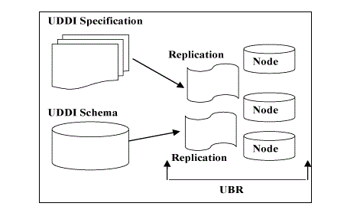
Cont’d
UDDI - Technical Architecture

Slide 142
ASSIGNMENT
What is micro service? How can we build micro service using PHP? Write sample code.
Note: should be hand written with max of two page.

Slide 143
What is a Cookie?
A cookie is often used to identify a user. A cookie is a small file that the server embeds on the user's computer. Each time the same computer requests a page with a browser, it will send the cookie too. With PHP, you can both create and retrieve cookie values.
A session is a way to store information (in variables) to be used across multiple pages.
Unlike a cookie, the information is not stored on the users computer.

Slide 144
PHP File Upload

